Slide 1

SANDISK PROJECT
By Thunder - Cybertek

Slide 2
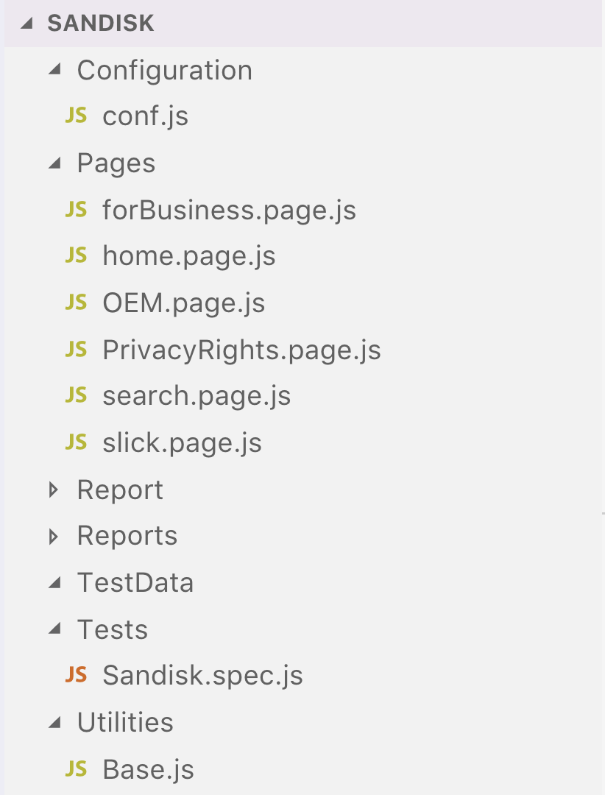
Framework
More clear
More understandable
More readable
Less and clean code
Interact with page from test to page objects

Slide 3
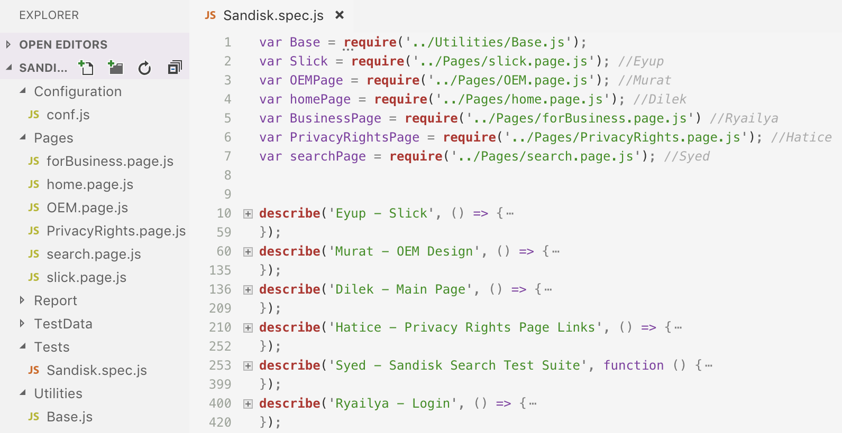
Framework
1 spec file
6 test suites
6 page object files
38 test cases

Slide 4
Eyup
Testing Functionality
Slides
4 test cases have been created
4 Positive
1 Bug (not user friendly)
Test data was not used
Challenging parts;
Using the counting part without promise
Waits

Slide 5
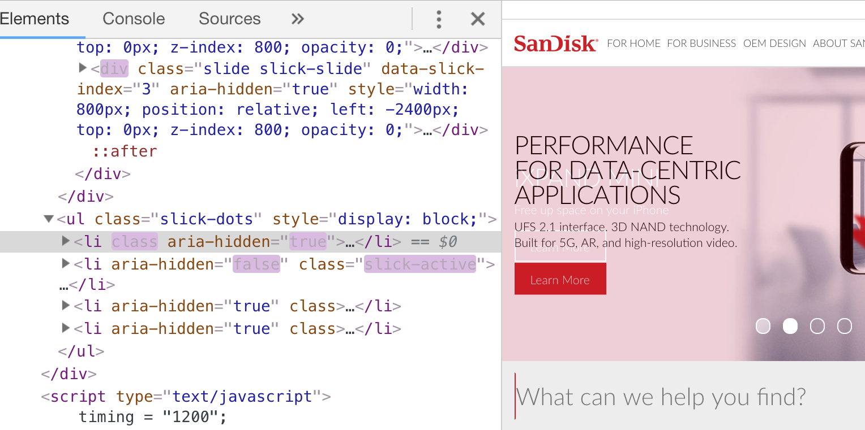
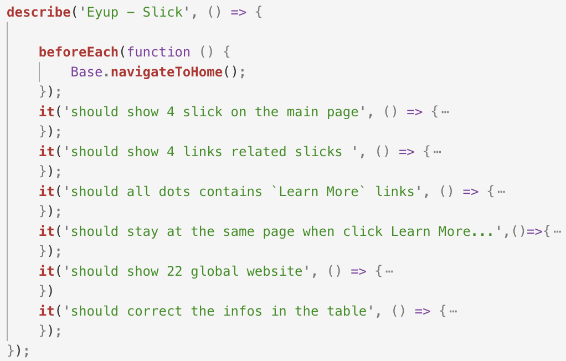

Slide 6
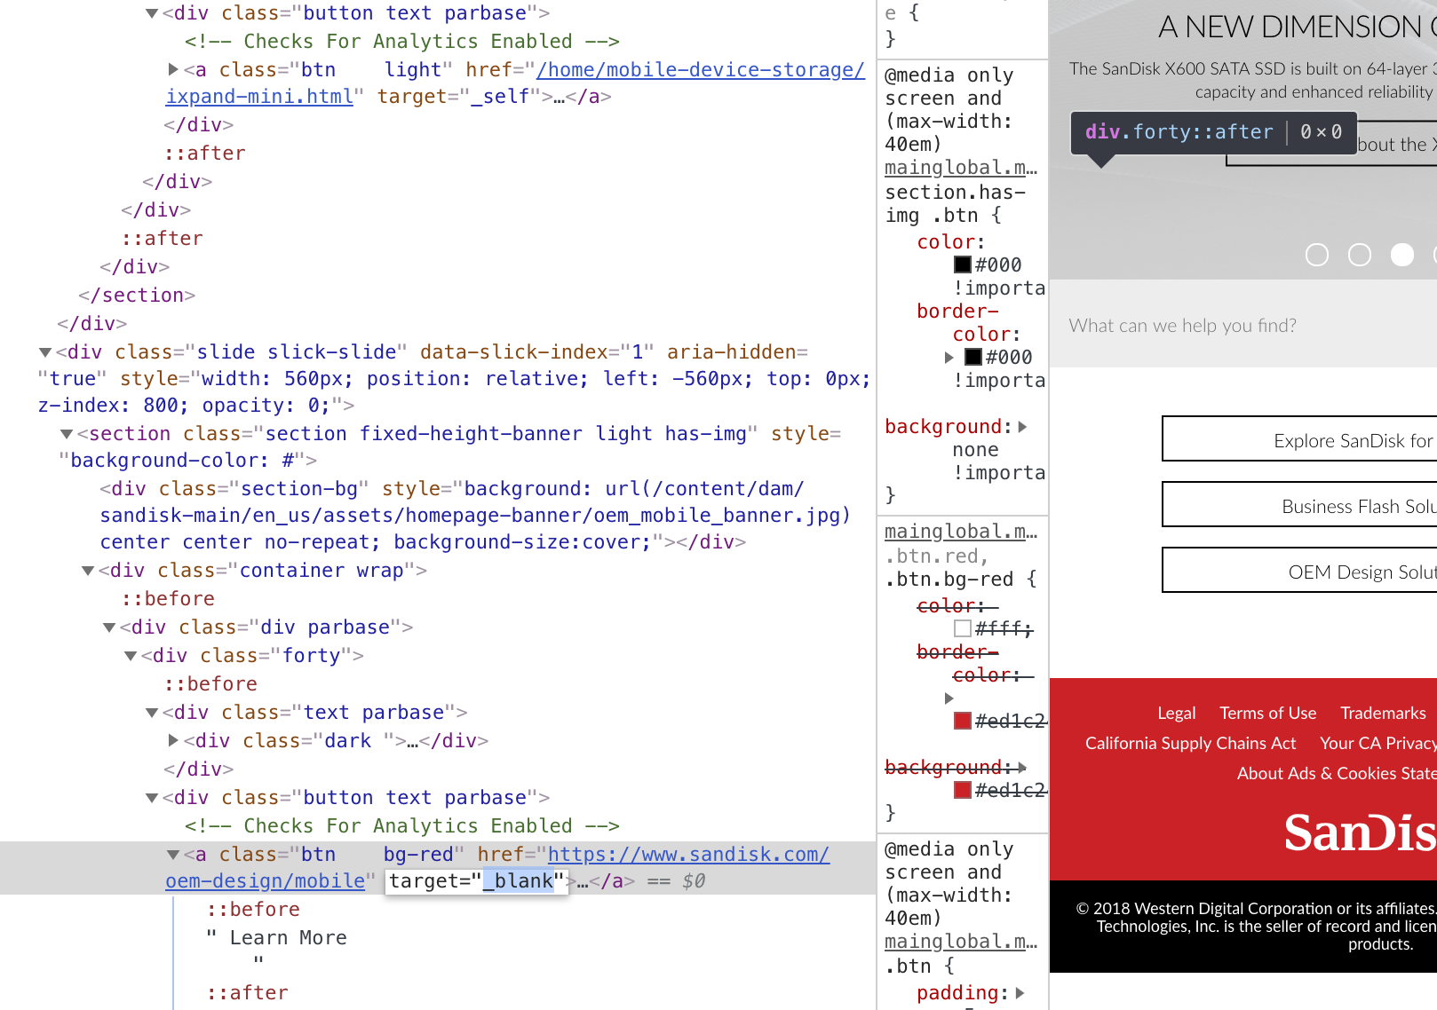

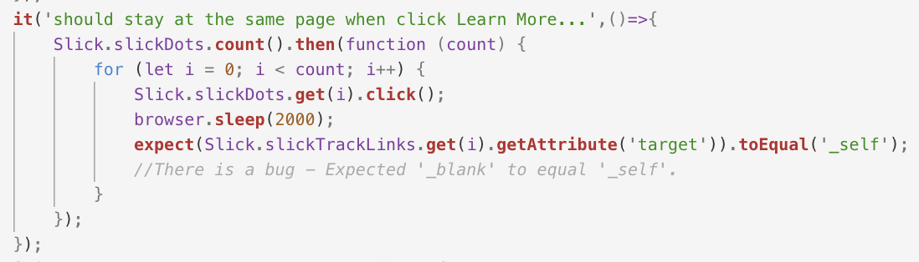

Slide 7
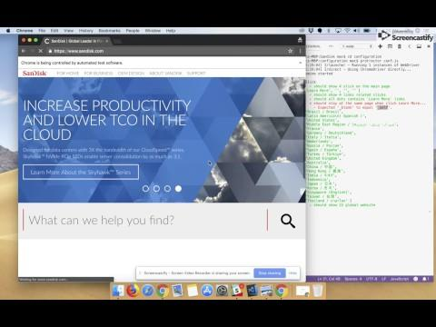

Slide 8
Dilek
Testing For Home Page functionality.
The functionality has been tested.
TEST CASES
5 is positive test cases.
2 is negative test cases.
The For Home Button should be enabled on the main page.
The For Home Button should be displayed on the main page
On the For Home page should be displayed the the device species and options list …
On the For Home page should be matched he the device species and options list…
On the For Home page should be displayed the Product Type…
On the For Home page, should be displayed HOST TYPE list
On the For Home page should not be matched the Product list :
While coding main challenge was:
comparing the product lists with expected list was challenging.
finding locators which are not unique.

Slide 9


Slide 10
Ryailya
Test Functionality
Business Page
Test Cases
Should navigate to Home Page
Should navigate to For Business Page
Should display elements as Data Center, Computing, Professional Photo &Video
Should click on Connect with Solutions expert button
4 Test cases has been created:
All positive
Test Data is not required

Slide 11
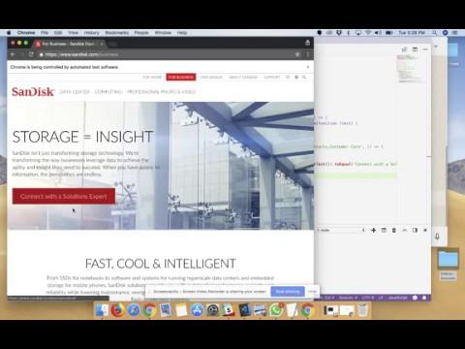

Slide 12
Hatice
Privacy Rights Page
Test Cases
Positive Test Cases
Scroll down click on "Your CA Privacy Rights Page
Verify Children link is clickable, navigating to correct path & title displaying correctly
Confirm "Third-Party Websites and Services" is not displayed as any other title
Print the paragraph listed in " Collection and Use of Personal Property" Link
Negative Test Case
"Contact us" should not navigate to its path and give an error because of its non-angular Functionality
Challenges
-Syntax issues
Ex/
→ expect(PrivacyRightsPage.linkButton).isDisplayed()).toBe(true);
→ PrivacyRightsPage.paragrapghList.getText().then(function(items){
console.log(items); }
-Getting used to create framework!!
-Locating Elements - Link elements are containing same link with multiple outcome & with no id, class & unique name

Slide 14
Murat
Testing OEM Page functionality.
The functionality has been tested.
5 test cases have been created.
4 are positive test cases.
1 is negative test cases.
Sandisk The "OEM Design" page should be displayed.
On the"OEM Design" page tabs all sub-links should be clickable :...
On the "OEM Design" page Region and Country dropdown list should be selectable and store list should be displayed.
On the "OEM Design" page OEM Design Inquiries form should be send via email.
On the OEM Design Inquiries form, required fields should be displayed.

Slide 15
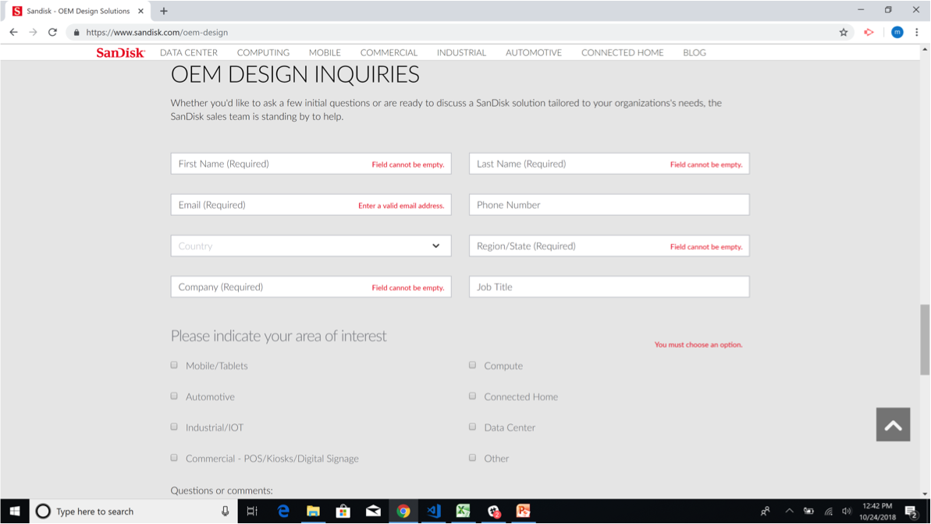
Murat
While coding main challenge was:
finding locator: while using linkText locator, we should check first whether it is uppercase or not.
In negative test case: wait

Slide 16
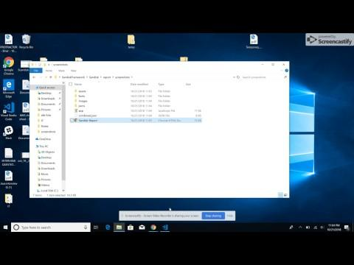

Slide 17
Syed
Testing Functionality
Search
8 test cases have been created
7 Positive
1 Negative
Test data used
‘iXpand’, ‘Skyhawk’, ‘Sandisk’
Challenging part;
Promises

Slide 19
LEARN
Teamwork
Help each other
Communicate more
More meeting to finish on time
Problem Solving
Productivity
Learn different and new way approach
Practice more

